Slide 1
How to save your game in Stencyl

Slide 2
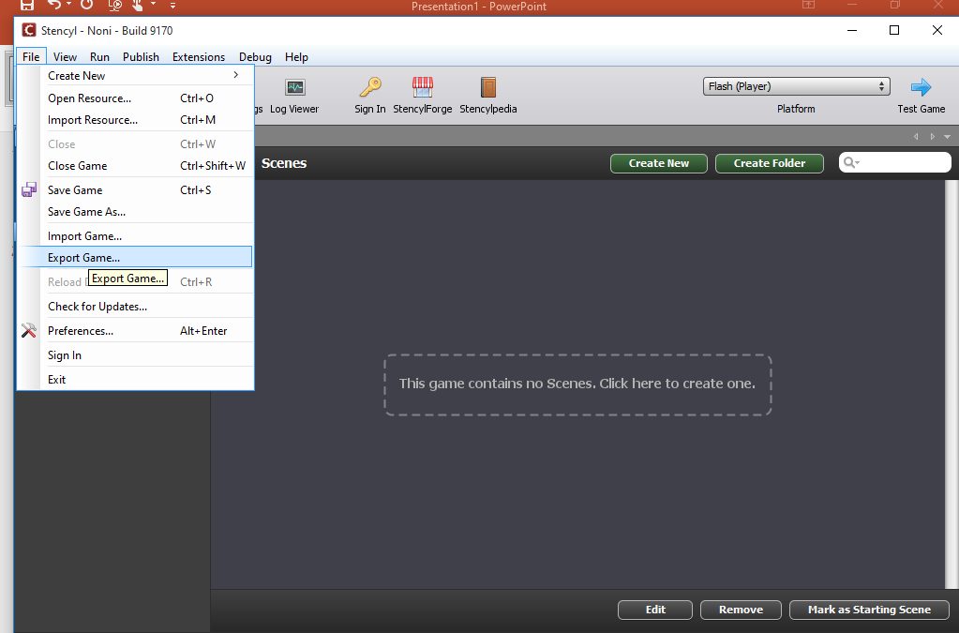
Go to file-> Export Game->

Slide 3
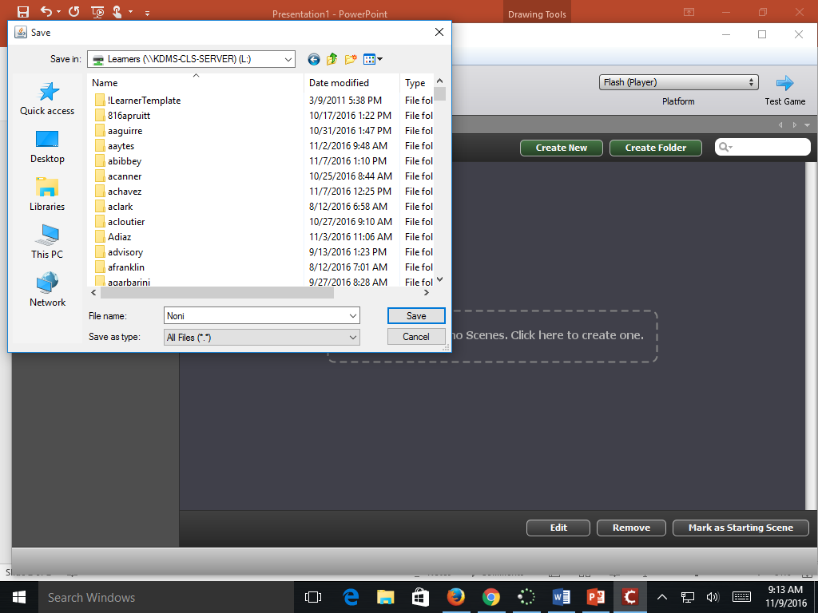
Click on This PC, and scroll down until you see the Learners Drive. Click on the Learners Drive and then find your name and save it to your drive.

Slide 4
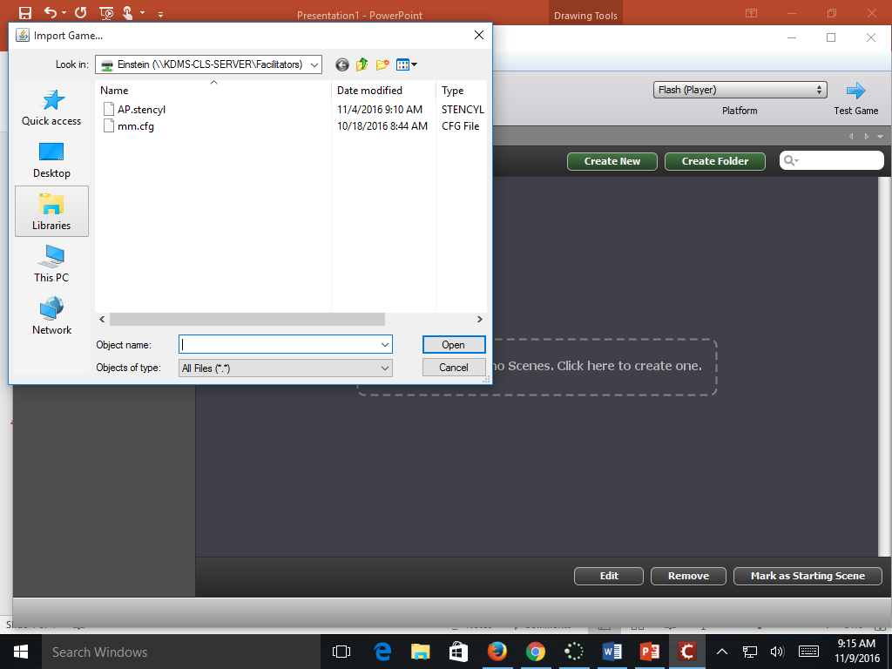
To boot up your game the next class period, go to File-> Import Game. Click on your saved game and it will import it into Stencyl for you to work on. Make sure you save your game as you go.

